Slide 1
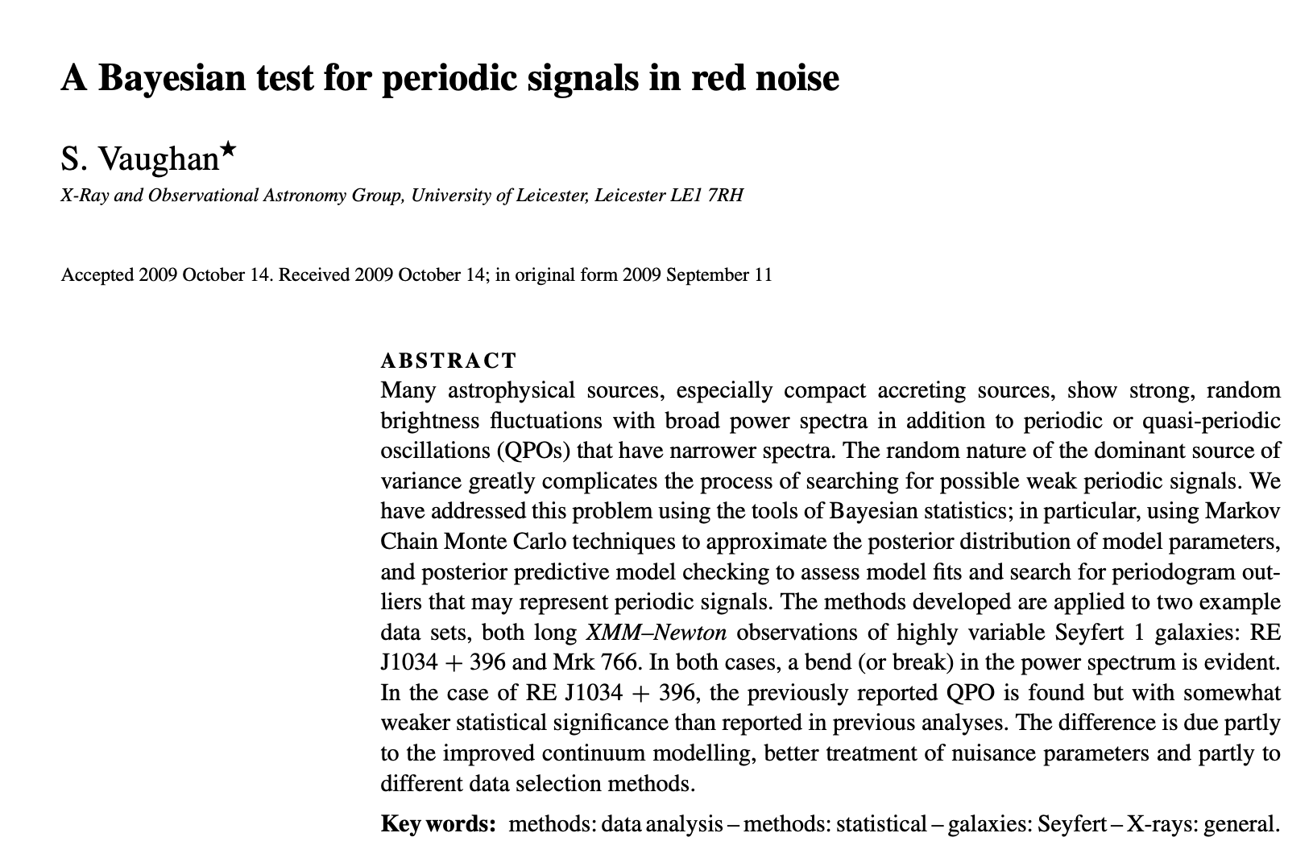
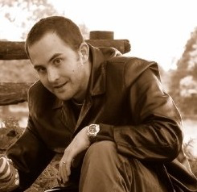
HOMEWORK 2
Simon Vaughan

Slide 2
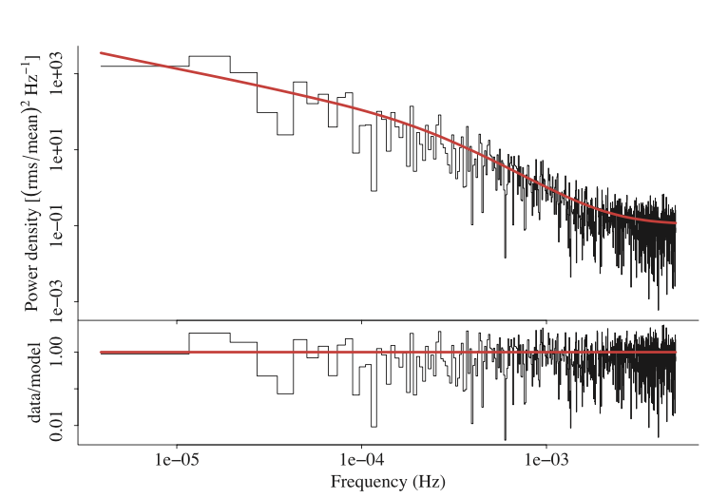
How to deal with a “coloured” noise in spectral analysis.

